Slide 1


Presentation of Credit EDA
By Ashish Kumar Jha

Slide 2
Objective
This is a process of analysis, which refers to credit data analysis to help banking or financial organization to make a decision on approving loan to the right applicant based on applicant’s profile which means to look at the outcome of default and non-default applicants.
Exploratory Data Analysis EDA - involves using statistics and visualizations to analyze and identify trends in data sets. The primary intent of EDA is to determine whether a predictive model is a feasible analytical tool for business challenges or not. EDA helps data scientists gain an understanding of the data set beyond the formal modeling or hypothesis testing task

Slide 3
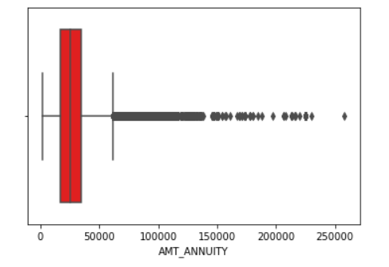
Data Analysis on Continuous Variable of Application Data
AMT_ANNUITY (Loan annuity) was having outlier null value or unexpected value that was exceeding to 250000 amount as shown in below diagram, those values has been imputed with median value i.e., 24903.

Slide 4
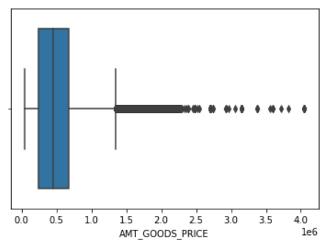
Data Analysis on Continuous Variable of Application Data
AMT_GOODS_PRICE (For consumer loans, it is the price of the goods for which the loan is given) was having outlier null value that were exceeding to 450000 as shown in below graph, those values have been imputed with median value i.e., 450000.

Slide 5
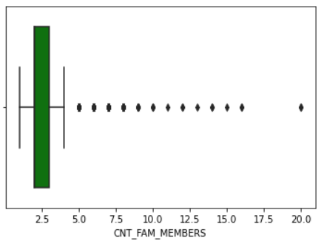
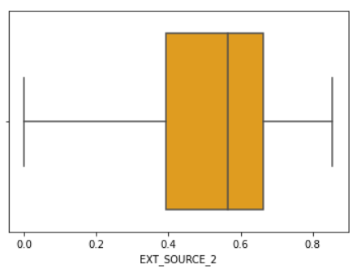
Data Analysis on Continuous Variable of Application Data
CNT_FAM_MEMBERS (Count of family members client have) was having outlier null value that was exceeding to 20 as shown in below graph, those values have been imputed with median value i.e., 2.
EXT_SOURCE_2 (Normalized score from external data source) was not having any outlier null value as shown in below graph. Hence, those values have been imputed with mean value i.e., 1.

Slide 6
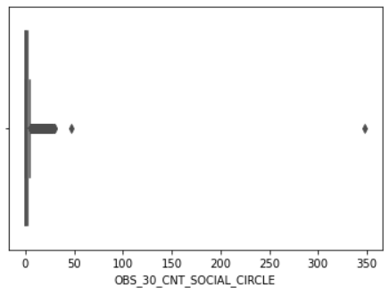
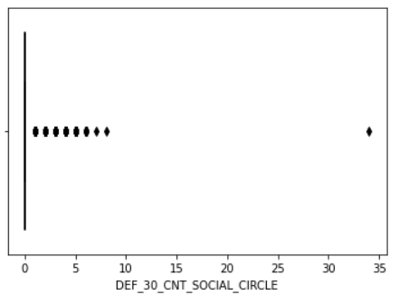
Data Analysis on Continuous Variable of Application Data
OBS_30_CNT_SOCIAL_CIRCLE (Count of observation of client's social surroundings with observable 30 days past due default) was having outlier null value that were 350 approx. as shown in below graph. Those values has been imputed with median value i.e., 0.
DEF_30_CNT_SOCIAL_CIRCLE (Count of observation of client's social surroundings defaulted on 30 DPD days past due) was having outlier null value that was 34 approx, as shown in below graph. Those values have been imputed with median value i.e., 0.

Slide 7
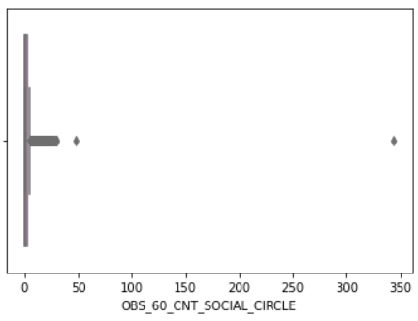
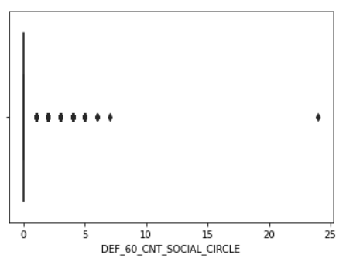
Data Analysis on Continuous Variable of Application Data
OBS_60_CNT_SOCIAL_CIRCLE (Count of observation of client's social surroundings with observable 60 days past due default) was having outlier null value that was 350 approx, as shown in below graph. Those values has been imputed with median value i.e., 0.
DEF_60_CNT_SOCIAL_CIRCLE (Count of observation of client's social surroundings defaulted on 60 days past due) was having outlier null value that was 24 approx, as shown in below graph. Those values has been imputed with median value i.e., 0.

Slide 8
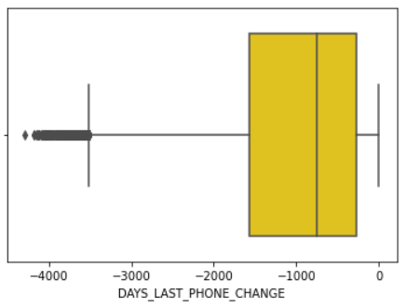
Data Analysis on Continuous Variable of Application Data
Imputing values in Categorical variable
DAYS_LAST_PHONE_CHANGE (Count of days before application did client change phone) was having outlier null value that was 24 approx, as shown in below graph. Those values has been imputed with median value i.e., -757.
NAME_TYPE_SUITE (Who was accompanying client when he was applying for the loan) can be imputed with value with mode of the column which is unaccompanied.

Slide 9
Checking for Datatypes and changing to correct Datatypes
Those columns which was having incorrect datatypes have been changed to the correct datatypes, also, renamed values of some column with full form of it.
For example –In CODE_GENDER column the values was present as ‘M’, ‘F’ and ‘XNA’. So, XNA has been ignored and changed the value of ‘M’, ‘F’ as ‘Male’ and ‘Female’.
In FLAG_OWN_CAR column the values was present as ‘Y’ and ‘N’. So, renamed the values as ‘Yes’ and ‘No’.
In FLAG_OWN_REALTY column the values was present as ‘Y’ and ‘N’. So, renamed the values as ‘Yes’ and ‘No’.
New column has been created that is Age with the age of every applicants.

Slide 10
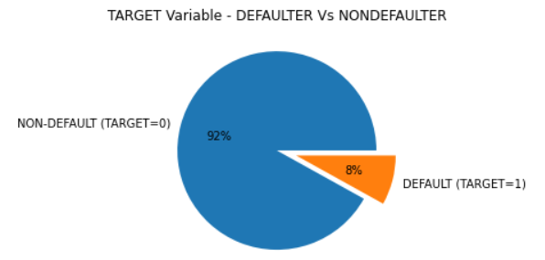
Checking Imbalance in Target column
Using this pie plot, we have a clear understanding that there are huge imbalance between defaulters and non-defaulters. This plot states that 92% of applicants are non-defaulters whereas 8% of applicants are defaulters.

Slide 11
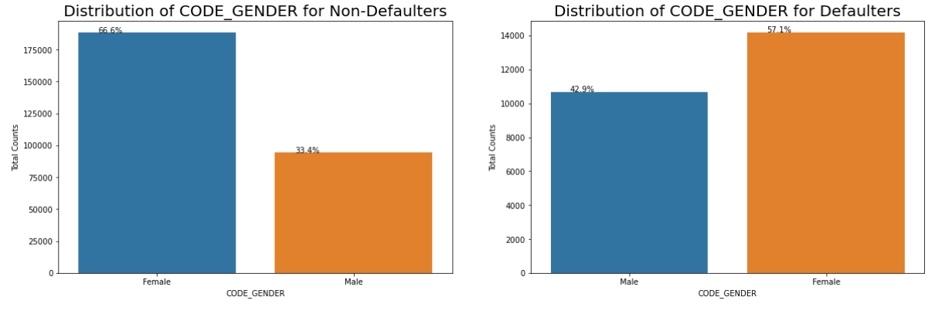
Univariate analysis on Categorical variable
Through this plot diagram we can understand that the %age of female applicants are higher in comparison of male applicants to the non-defaulters i.e., approx 67% of female are non defaulters whereas 33% of male are non-defaulters, whereas %age of females are higher than males in defaulters diagram also, this means count of female applicants are more than that of male applicants.

Slide 12
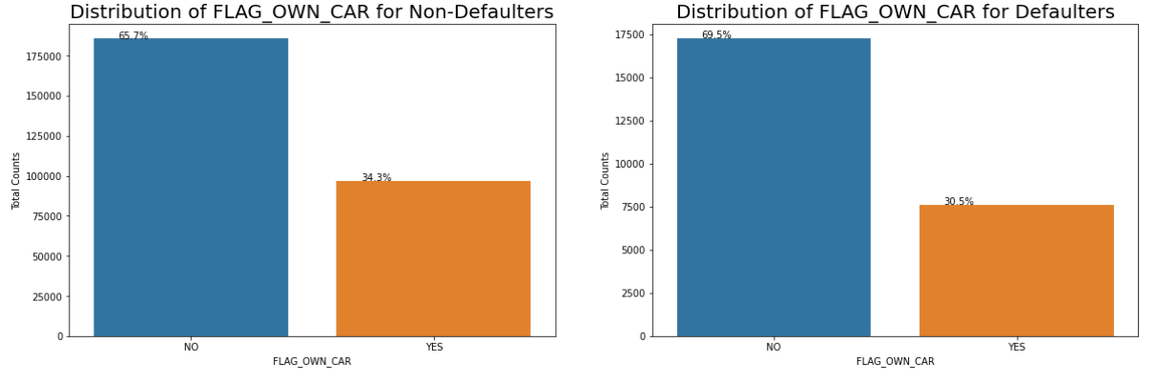
Univariate analysis on Categorical variable
We can see that people with cars contribute 65.7% to the non-defaulters while 69.5% to the defaulters. While people who have car default more often, the reason could be there are simply more people without cars. Looking at the percentages in both the charts, we can conclude that the rate of default of people having car is low compared to people who don't.

Slide 13
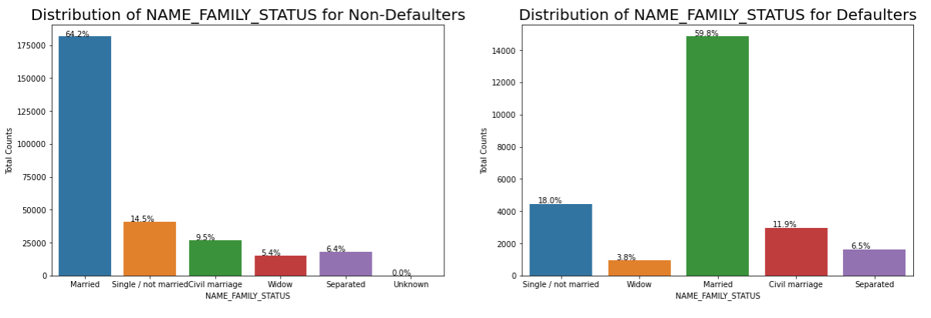
Univariate analysis on Categorical variable
Married people tend to apply for more loans comparatively
But from the graph we see single/non married people contribute 14.5% to non-defaulter and 18% to defaulters. So there is more risk associated with them.

Slide 14
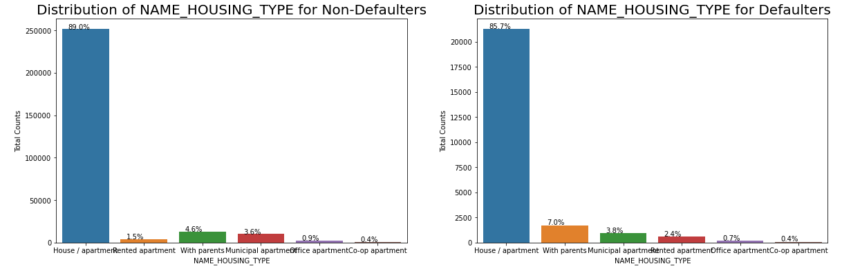
Univariate analysis on Categorical variable
It is clear from the graph that people who have house/apartment, tend to apply for more loans.
People living with parents, tend to default more often when compared with others. The reason could be their living expenses are more due to their parent living with them.

Slide 15
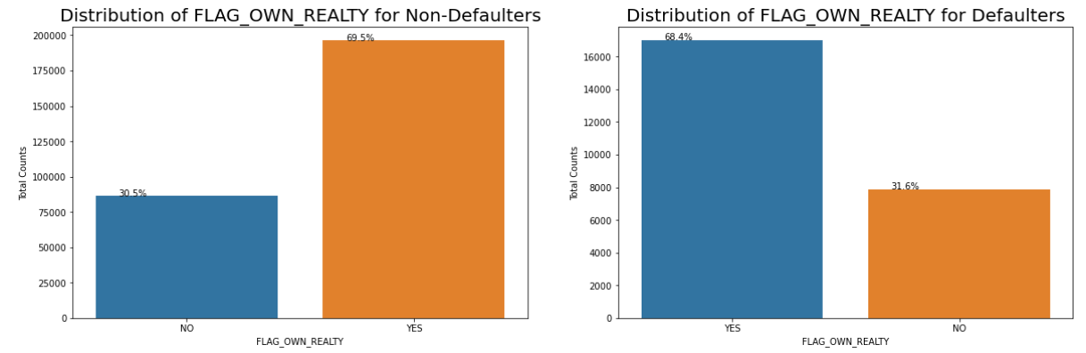
Univariate analysis on Categorical variable
Those applicants are higher in percentage of non-defaulters, who have their own houses and property.
Same result as well for defaulters, which means the applicants who have their own property have filled maximum application for the loan

Slide 16
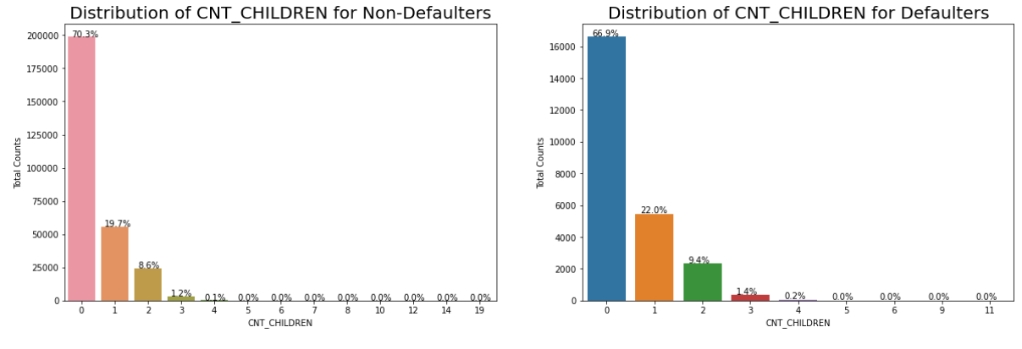
Univariate analysis on Categorical variable
Approx 70% of applicants who have children are counted are Non-Defaulters and 66% applicants who are having children are defaulters

Slide 17
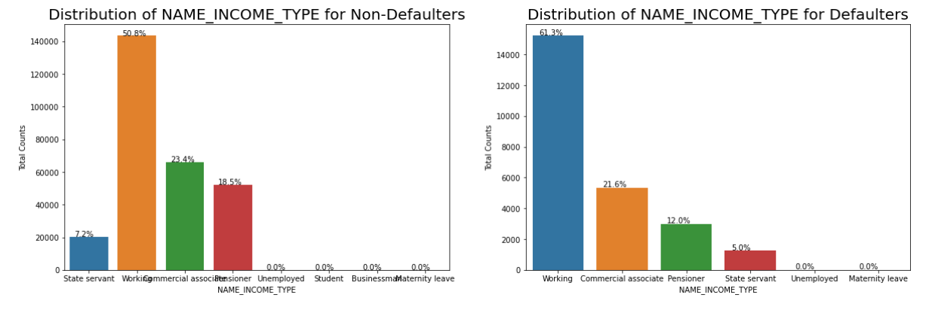
Univariate analysis on Categorical variable
Income distribution represents that 50% of applicants who are working are counted as non defaulters and 23% who are commercial, 18% who are pensioners, 7% who are state servants are counted as non defaulters. Whereas, 61% of applicants who are working are counted as defaulters, commercial 21% commercial, 12% pensioners, 5% state servants are counted as defaulters.

Slide 18
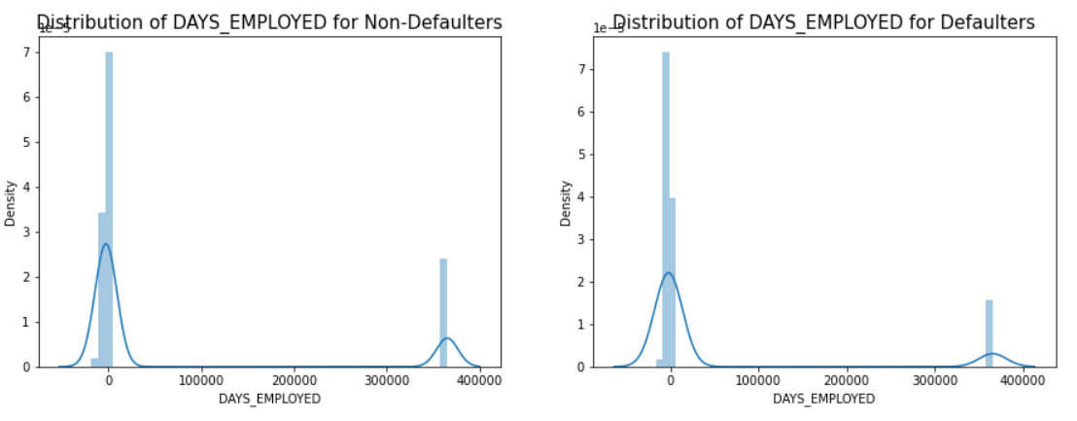
Univariate analysis on Continuous Variable
As we can see from the distribution graph that the peak is for the applicants who are 0 days employed are stated as non defaulters. Whereas, applicants 0 days employed for defaulters are also having the peak.

Slide 19
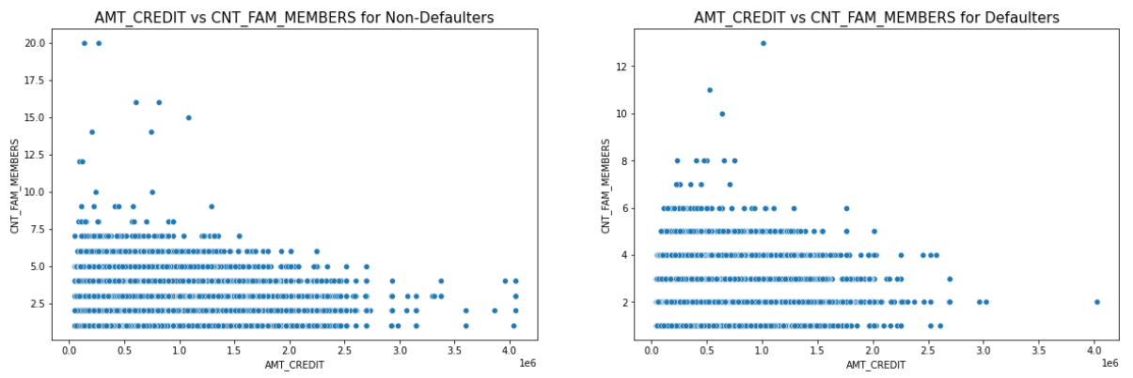
Bivariate Analysis of Continuous Variables
We can see that the density in the lower left corner is similar in both the case, so the people are equally likely to default if the family is small and the AMT_CREDIT is low. We can observe that larger families and people with larger AMT_CREDIT default less often.

Slide 20
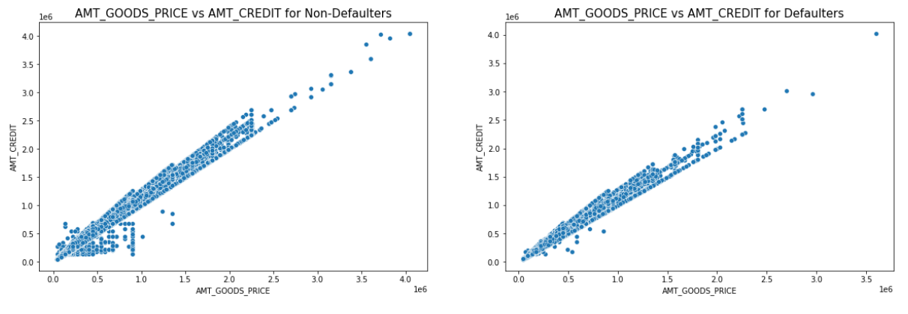
Bivariate Analysis of Continuous Variables

Slide 21
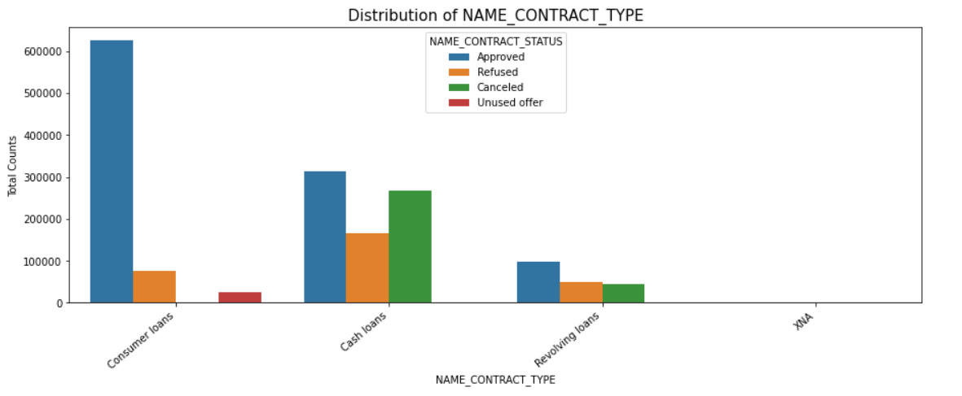
Data Analysis For Previous Application Data
From the above chart, we can infer that, most of the applications are for 'Cash loan' and 'Consumer loan'. Although the cash loans are refused more often than others

Slide 22
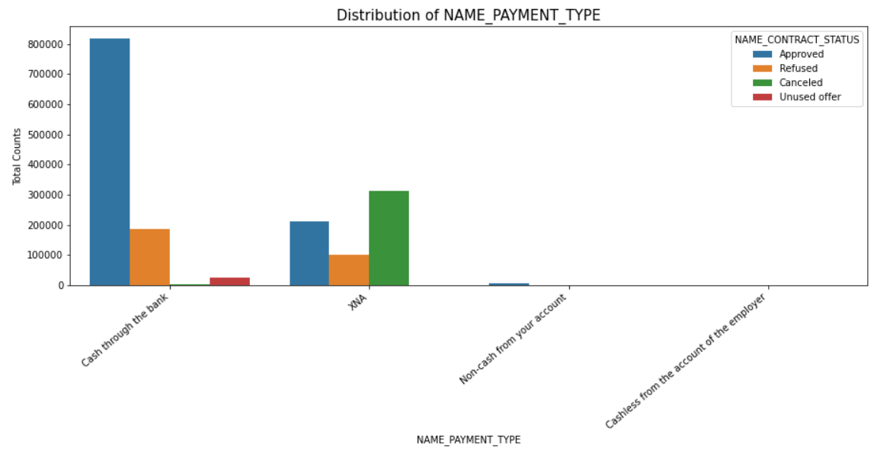
Data Analysis For Previous Application Data
From the above chart, we can infer that most of the clients chose to repay the loan using the 'Cash through the bank' option We can also see that 'Non-Cash from your account' & 'Cashless from the account of the employee' options are not at all popular in terms of loan repayment amongst the customers.

Slide 23
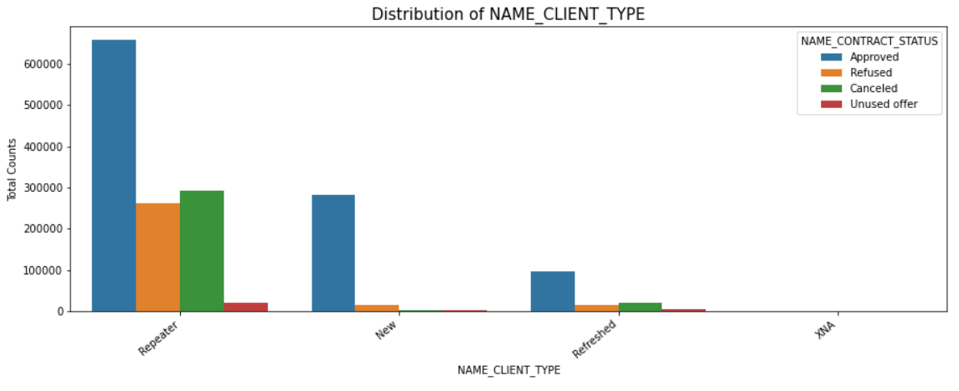
Data Analysis For Previous Application Data
Most of the loan applications are from repeat customers, out of the total applications 70% of customers are repeaters. They also get refused most often.

Slide 24
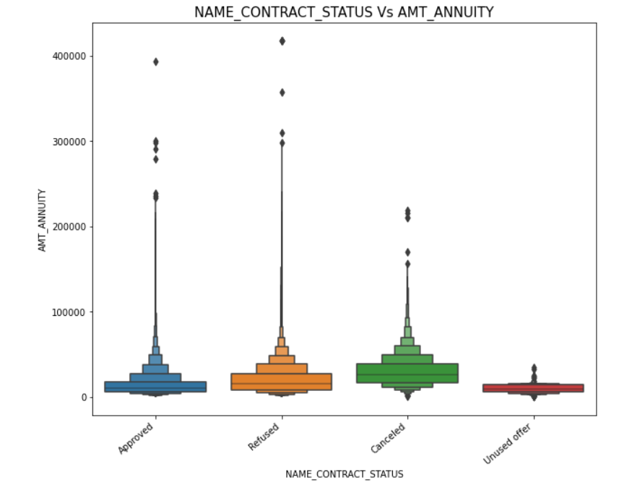
Using box plot to do Bivariate Analysis on categorical and numeric columns
We can infer that when the AMT_CREDIT is too low, it get's cancelled/unused most of the time.
We also see that applications with too high AMT ANNUITY also got refused more often than others.

Slide 25
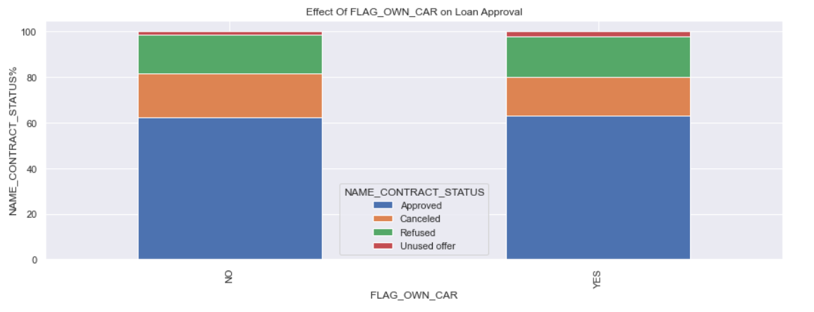
Merging Application data and Previous Application data
We see that car ownership doesn't have any effect on application approval or rejection. But we saw earlier that the people who has a car has lesser chances of default. The bank can add more weightage to car ownership while approving a loan amount.

Slide 26
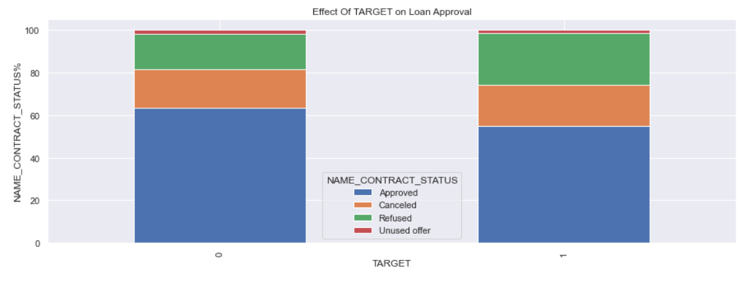
Merging Application data and Previous Application data
We can see that the people who were approved for a loan earlier, defaulted less often where as people who were refused a loan earlier have higher chances of defaulting.

